Slide 1
CT Cementing
November 2017
Jalal Alali
COPYRIGHT GWDC,WT

Slide 2
Content
1、Brief Introduction
2、Basic procedure
3、ERP for CT stuck
4.Case experience share

Slide 3
1.Brief Introduction
The process of forcing cement slurry through perforations, holes or leaks in the casing/liner to obtain a seal.
Squeeze cementing treatments are commonly designed to resolve:
  Water or gas channelling (primary cement job failure)
  Injection water (or gas) break-through
  Gas or water coning
  Isolation of unwanted perforations
  Losses to a thief zone or improved injection profile

Slide 4
1.Brief Introduction
Squeeze cementing operations performed through a CT string have several benefits/advantages:
  Thru-tubing intervention
  Integrated operations
    e.g., fill removal, well kick-off
  Accurate slurry placement
    “mobile” injection point
  Reduced contamination of small volume treatments
  Time, product and cost savings - proven!

Slide 5
2.Basic Procedure
Job Design
Critical job design parameters include:
  Slurry volume
  Slurry placement
  Depth correlation
  Protection against contamination
  Cement column stability
  Tool (nozzle selection)

Slide 6
2.Basic Procedure
Slurry Volume
Considerations for slurry volume include:
  Length of interval and capacity of casing/liner
  Presence of void areas behind perforations
  Force on CT string
    e.g., additional tension caused by string weight
  Configuration of mixing equipment and surface lines etc.
  Ability or requirement to use of cement plugs, pigs or darts

Slide 7
2.Basic Procedure
Slurry Placement
Considerations for slurry placement include:
  Depth control (including correlation)
  Contamination protection during placement
  Cement column stability
  Isolation of adjacent (untreated or sensitive) zones
  Tubing movement (control and coordination)

Slide 8
2.Basic Procedure
Cement Column stability
Slurry settles on platform
Slurry “ropes” and contaminates
Sand plug
Effect of stable platform

Slide 9
2.Basic Procedure
Tool Selection
Principle:
Choose the small size nozzle , the 1.69” nozzle is best for job;
Choose the big port nozzle for prevent the port is plugged;
Try the best to pass the obstruction by bending the tubing.

Slide 10
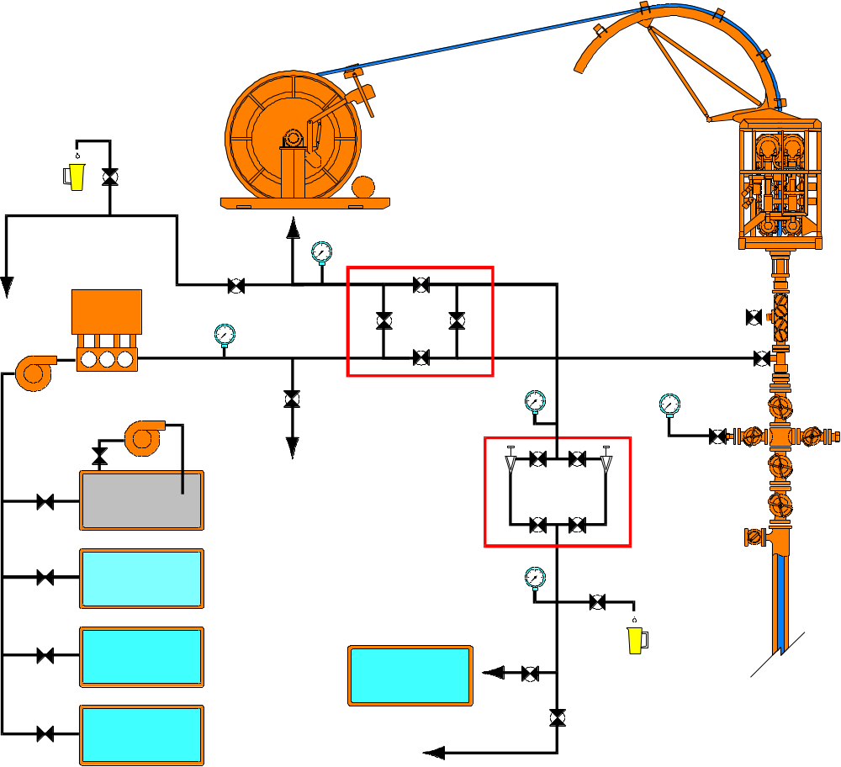
2.Basic Procedure
Typical Rig-up
Sample point
Squeeze manifold
Cement
Choke manifold
Water
Displacement fluid
Sample point
Typical cement equipment configuration

Slide 11
2.Basic Procedure
Responsibilities
  1.The Job Supervisor:
  Must comply with all procedures and must not allow OTS employees to be exposed to risk levels that are assessed as unacceptable.
Know and understand the requirements of these guidelines and any other OTS standards.
Cooperate with the client to ensure all jobs comply with OTS procedures and any client or regulatory requirements.
Correctly equipped and maintained equipment.
The competent personnel for safe operations.
The appropriate training so that employees understand their responsibilities.

Slide 12
2.Basic Procedure
Responsibilities
  2.The CT Crew:
Must comply with all procedures. The crew will undertake any task that the Job Supervisor delegates to proceed with the operation. The crew will ensure that they are fully aware and conversant with any task they have been asked to perform. At no point must the crew members expose themselves to any unacceptable levels of risk. If any changes occur during an operation or task being performed, the crew members must stop immediately, identify any additional hazards and ensure any resultant risks are controlled within acceptable limits before proceeding. If further clarity is required, authority to proceed must be approved by the relevant supervisor.
Know and understand the requirements of these guidelines and any other OTS standards.
Cooperate with the client to ensure all jobs comply with OTS procedures and any client or regulatory requirements.

Slide 13
2.Basic Procedure
Procedure
Safety Meetings
Prior to commencement of Cementing thru Coiled Tubing Operations, a safety meeting (or Tool Box Talk) is to be held with all relevant personnel. Discussions will include, but are not limited to, individual roles and responsibilities for the operation, with emphasis on safety, job of OTS actives, co-ordination of activities and lines of communication.

Slide 14
2.Basic Procedure
Procedure
Safety Meetings
A location assessment can be done to identify any hazards or risks and the actions to control these risks must be discussed at this meeting.
After the equipment is rigged up and tested, a final toolbox talk is to be held before beginning any work.
Notice: The Client representative should be invited to attend these meetings.
Notice: Every individual must identify the hazards associated with their work and take time out for safety. Where there is any doubt about their ability to carry out the job safely, they must seek guidance from their supervisor.

Slide 15
2.Basic Procedure
Procedure
Job Review and Planning
It is recommended to hold planning meetings with clients to review the job design, procedures and contingency plans. Typical areas of review will include but not be limited to:
Job objectives
Responsibilities of personnel.
Review of job procedures (client and OTS).
Review of contingency plans.
Checklist for the safety meetings.

Slide 16
2.Basic Procedure
Procedure
Slurry Design
The design of the cement slurry will vary according to the specific well data collected as part of the job planning and review. The slurry should be optimised to achieve the objectives in the specific well and operational conditions.
This will include the adjustment of the thickening time, the rheology, fluid loss, free water and set cement characteristics.
As a minimum, slurries should be laboratory tested to confirm suitable properties in accordance with API standards. These tests should, where practical, be carried out using samples of both water and cement from the rig in question.
Notice: The sample job is necessary! The raw material and mixed slurry should be taken sample separately!

Slide 17
2.Basic Procedure
Placement Technique
Cement Dump.
Used to place cement using some type of support system, either mechanical (e.g. the bottom of the well) or hydraulic (e.g. high viscosity pill) or inject into a large thief zone. Generally this system is only used where some degree of contamination of the slurry is not an issue or where laying in the slurry is not possible e.g. Gas wells.
The slurry is pumped from the coiled tubing and allowed to either fall or is injected down the well to the support system or into the formation. The Coiled-tubing nozzle is kept above the thief zone and or the theoretical top of cement.

Slide 18
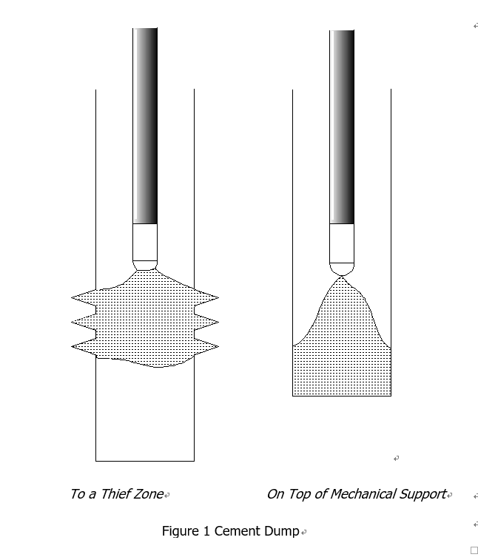
2.Basic Procedure
Placement Technique
Cement Dump.

Slide 19
2.Basic Procedure
Placement Technique
Laid Plug
Used to place slurry with minimum contamination. The technique may be used with a mechanical or hydraulic support, as mentioned above.
As the slurry is pumped from the coiled tubing, the coiled tubing is POOH at a speed equivalent to the cement fill up in the casing. The nozzle is kept just inside the plug throughout the placement greatly reducing the contamination effects.

Slide 20
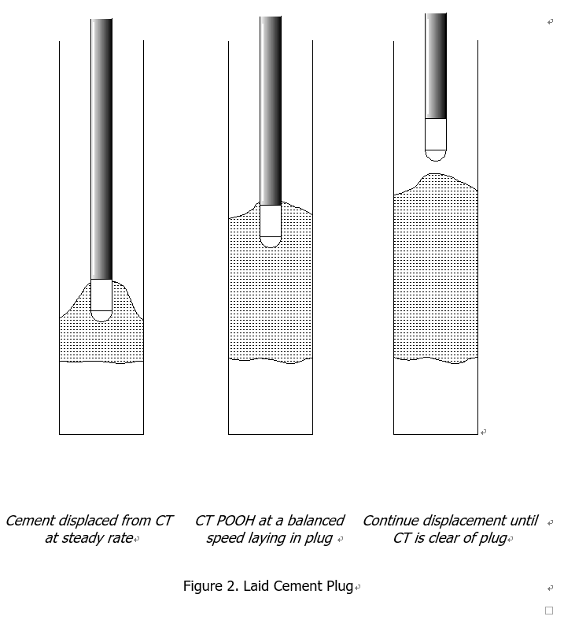
2.Basic Procedure
Placement Technique
Laid Plug

Slide 21
2.Basic Procedure
Placement Technique
Cement Squeeze
A cement squeeze is used to force cement in to the formation / perforations to create a seal in the near well bore which allows the well bore itself to be maintained ( recovered ).
The system is generally used to close off entire perforated intervals as no diversion is provided.
A hesitation squeeze may be used to aid the start of bridging off in cases where cement may be injected into the formation without the squeeze pressure being achieved.

Slide 22
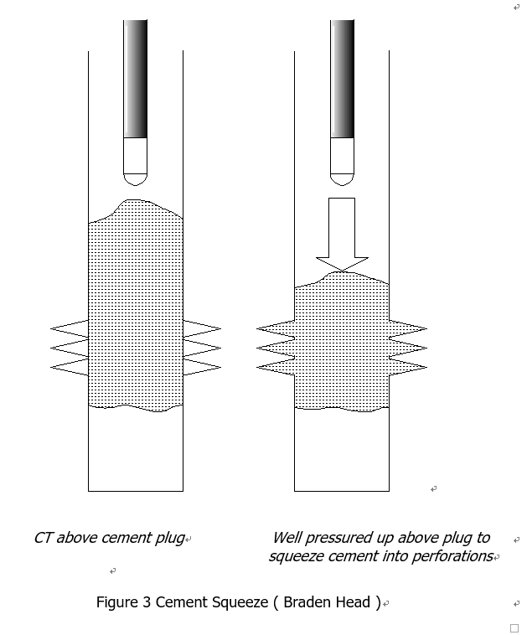
2.Basic Procedure
Placement Technique
Cement Squeeze

Slide 23
2.Basic Procedure
Procedure example
AZNN-13# cement proposal

Slide 24
3.ERP for CT stuck
COILED TUBING STUCK IN THE HOLE
There are two scenarios by which the coiled tubing is defined as stuck in hole.
(1)The coiled tubing itself is stuck at some point between the stuffing box and end connector.
(2)The BHA being conveyed is stuck.

Slide 25
3.ERP for CT stuck
COILED TUBING STUCK IN THE HOLE
The procedures that should be followed will depend upon several factors.
(1)Type of well; flowing oil or gas well, water injection well.
(2)Type of bottom hole assembly on coiled tubing.
(3)Type of operation being carried out when tubing became stuck.
In all cases the tubing can be defined as stuck in the well if it cannot be pulled out of the well without exceeding a stress of 80% of the weak link release rating or 80% of the minimum yield rating for the coiled tubing. Always use the lower of the two values when attempting to pull.

Slide 26
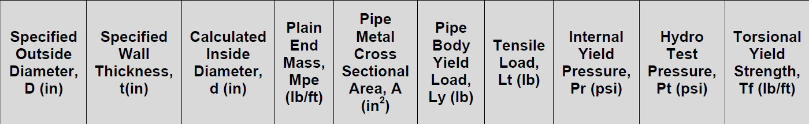
3.ERP for CT stuck
COILED TUBING STUCK IN THE HOLE
For 0.109” wallthickness:
Yield load=38110*0.453=17.263Ton
Max safety pull=Yield load*80%=13.8104Ton
For 0.134” wallthickness:
Yield load=4600*0.453=20.838Ton
Max safety pull=Yield load*80%=16.670Ton
NOTE: The max. Pull for the operator is 14 Ton.

Slide 27
3.ERP for CT stuck
COILED TUBING STUCK IN THE HOLE
(a) Inform company representative of conditions
(b) Inform OTS duty supervisor
From the operations being carried out and information available: about the well, try and determine reason f

Slide 28
3.ERP for CT stuck
COILED TUBING STUCK IN THE HOLE
Attempt to pull free by applying a steady pull up to a maximum of 80% of tubing minimum yield. If in doubt as to what this figure is consult engineering Department.
When applying this maximum pull, hold the maximum value for at least two minutes, Observe the trend on the weight indicator and chart, Measure the amount of pipe extension that is required when this pull is applied.

Slide 29
3.ERP for CT stuck
COILED TUBING STUCK IN THE HOLE
The following are options that may be appropriate depending on circumstance.
(1)If possible flow well or increase well flow in an attempt to remove any debris in wellbore holding tubing. Maintain maximum circulation through coiled tubing at same time. (2)Circulate acid across bottom hole assembly in an attempt to remove any acid soluble material that may be holding tubing.
(3)After consultation with company representative, and OTS duty supervisor. Release bottom hole assembly using emergency release.

Slide 30
3.ERP for CT stuck
COILED TUBING STUCK IN THE HOLE
(1)When attempting maximum pull, do not work coiled tubing violently across gooseneck by frequent reversals.
(2) Log number of cycle made over gooseneck when attempting to pull free and if in doubt as to the fatigue condition of the coiled tubing, consult the OTS operating base to determine the exact state of fatigue of the coiled tubing.
(3) If it is not possible to pull the tubing, hand off the tubing in the slips and close the pipe rams.
(4) After consultation with the company representative kill well and commence fishing operations.

Slide 31
3.ERP for CT stuck
COILED TUBING STUCK during cementing job
(1)Keep pumping with high volume.
(2)Max. pull is 14ton.
(3)Report to the duty supervisor and operation manager immediately.
(4)Try to Reciprocate to release the stuck.

Slide 32
4.Case experience share
XX# CT stuck by cement
Situation:
CTU group starts to rig up the equipment at XX #and after doing pressure test of equipment they start to RIH with the permission of client’s supervisor. During RIH they face with an obstruction at the depth of 2680 m which based on well condition it is considered as a sandy obstruction. The primary attempt to passing through the obstruction is pumping diesel that is not effective. Hence, client’s supervisor requests to pumping 10 BBL mud acid to remove the created obstruction. After communication between CTU supervisor with CTU manager, acid injection plan approves and they start to pumping 10 BBL acid, then after that continue to pumping diesel to displace the CT. After waiting for one hour, based on client’s supervisor decision, pump truck start to pumping 30 BBL water with rate of 1 BBL/min and 2000 PSI from the kill line. Subsequently they can remove the obstacle and pass through. After that CTU control cabin operator starts to 50 m POOH and then again continue to RIH. At 2684 again they face with another obstruction and they can remove it by pumping liquid. After that they continue to RIH to the depth of 2728 where the cement’s injection depth is. After preparing 2 BBL122 PCF cement, the pump truck starts to cement pumping through the CT with rate of 1 BBL/MIN and 3000 PSI at 2728 meters and then continues with pumping water to displace the CT. during this period of time, CT stay in mentioned depth about 30 minutes.

Slide 33
4.Case experience share
XX# CT stuck by cement
Situation:
According to the CTU supervisor’s calculation, after flowing out half barrel of cement from CT, start to POOH. During POOH, after about 3 meters at the depth of 2725 meters, CTU control cabin operator finds that the weight is increasing and at the same time a sound is heard from injector due to slippage of injector’s chain on CT, thus the control cabin operator increases the traction pressure to 1500 PSI to apply more force and continue to POOH. Gradually the weight indicator maintains to 18 TONS but he doesn’t stop POOH as well as he doesn’t report this abnormal situation to the CTU supervisor and continue to POOH. At the depth of 2709 meters, the control cabin’s operator asks CTU engineer to inform this condition to CTU supervisor. The supervisor comes immediately as soon as he got informed, but as he arrives there, suddenly they hear another sound and the weight indicator decrease at the depth of 2705 meters which it shows that the CT has been broken.

Slide 34
4.Case experience share
XX# CT stuck by cement
Emergency response:
After this issue, the CT operator continues to POOH slowly and two person go to the injector to check the CT. After 50-60 meters POOH, they find the CT come out of Stuffing box, hence CTU supervisor asks to stop POOH and close the BOP rams including pipe and slip instantly. As next step they close the well with the permission of client’s supervisor.

Slide 35
4.Case experience share
XX# CT stuck by cement
Reason analysis:
Direct Reason: CT broken due to over-pull Indirect Reasons: Cement liquid quality was not proper and it changed to be solid faster than normal (cement bonding). The control cabin’s operator didn’t follow up the operation rules regarding over-pull permissible range. The control cabin’s operator didn’t inform the abnormal condition to the CTU supervisor. Lack of communication. They had radios but radios didn’t work. Management Reasons: CTU Supervisor left the control cabin while sensitive operation. Incorrect crew arrangement by job supervisor Carelessness of job supervisor during shift change in order to not taking any action to providing proper communication device.

Slide 36
4.Case experience share
XX# CT stuck by cement
Reason analysis:
Due to using big nozzle (2.5”) to pass through the well obstructions and also collecting sand particles around nozzle while CT was stopped for about 30 minutes, subsequently could cause re-creation of obstruction. CT capacity calculation to determining the time when cement flowing out of CT nozzle was not accurate. Concrete creation due to mixing sandy particles with injected cement. Re-creation of obstruction around CT could occupied some part of casing in the target area which it caused cement comes up beyond expectation while cement injection.

Slide 37
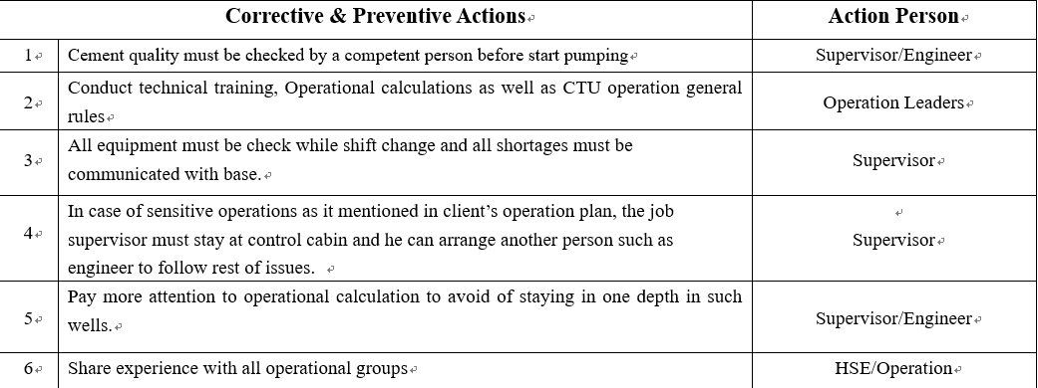
4.Case experience share
XX# CT stuck by cement
Corrective and preventive actions:

Slide 38
4.Case experience share
XX# CT stuck by cement
Q&A:
1.The reason analysis for the stuck happening
2.The wrong points after the stuck happened
3.The good points after the stuck happened
4.The key points reviews for cementing job
5.The key points reviews for CT stuck

Slide 39
Thanks!

